Slide 1

Anemoi

Slide 2
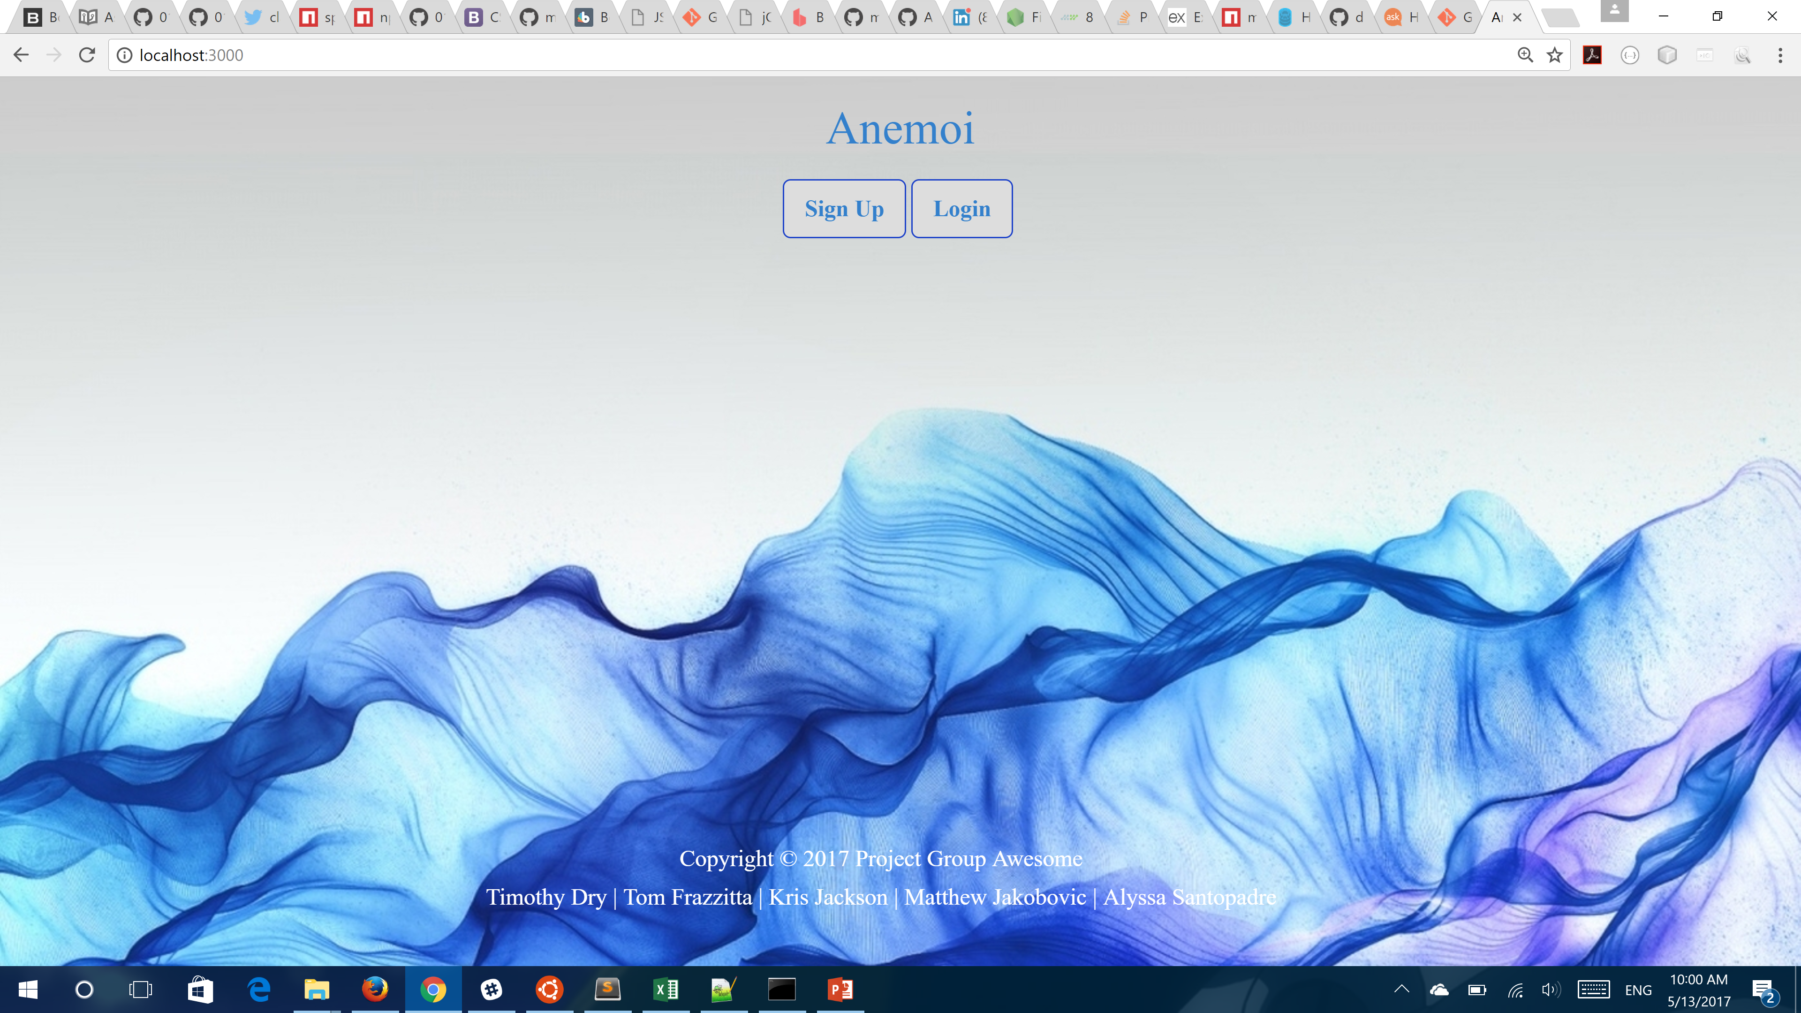

Slide 3
What is Anemoi?
Anemoi comes from Greek mythology: wind gods who were each ascribed a cardinal direction from which their respective winds came.
Anemoi is a site that helps users organize their tasks for the day.
The site asks for the user’s activities for the day and stores them.
After starting the tasks it gives directions from one task location to the next.

Slide 4
Technology used
Node.js
Sequelize
BodyParser
Express
Method override
Express-session
Passport
Cookieparser
Google Maps
Bcrypt
Bootstrap
sqlite3

Slide 5
Issues
The login and new users forms.
The Mysql database
Storing the user’s task locations
Git management
Many minor bugs

Slide 6
Future Goals
Use AI to predict the users' tasks on any given day.
Incorporate a way for users to complete as many task as possible right on the app. For example order groceries than just have to go pick them up.
Full integration with Nexmo

Slide 7
DEMO

Slide 8
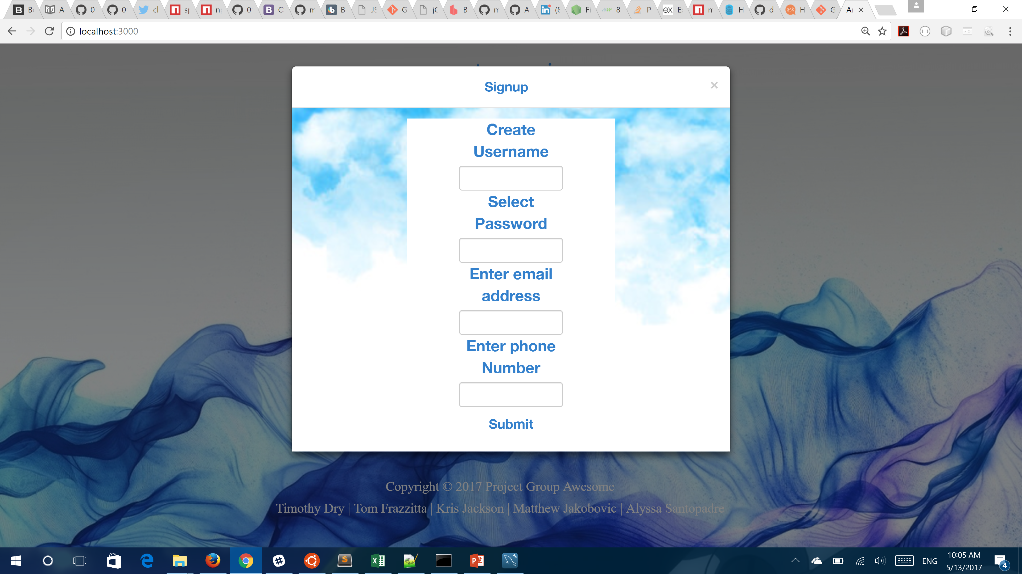
Signup

Slide 9
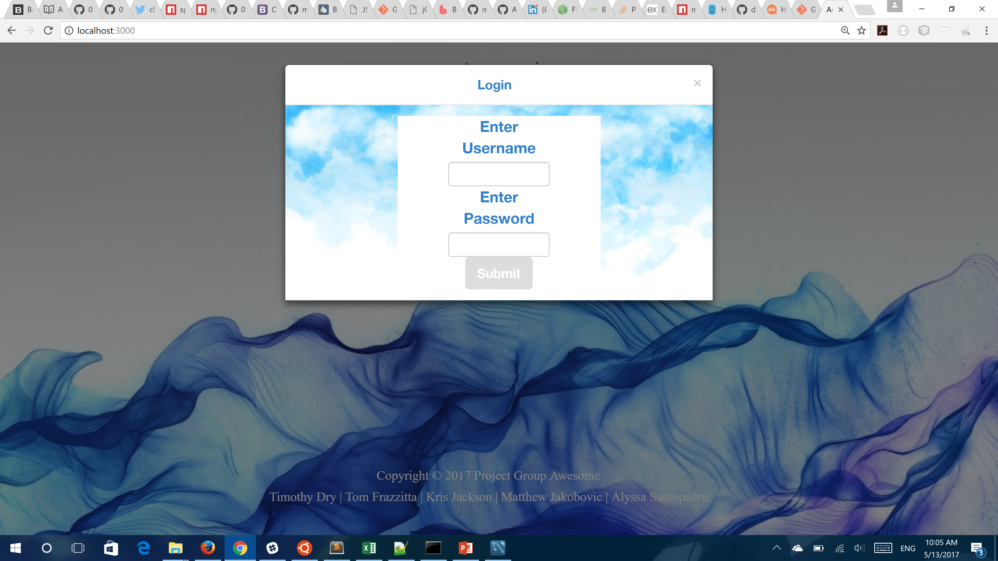
Login

